Slide 1
Ggplot2 and interactive graphics with R
Christophe Ladroue
SECTION 04
VIDEO 02
Non-linear trends
www.PacktPub.com

Slide 2
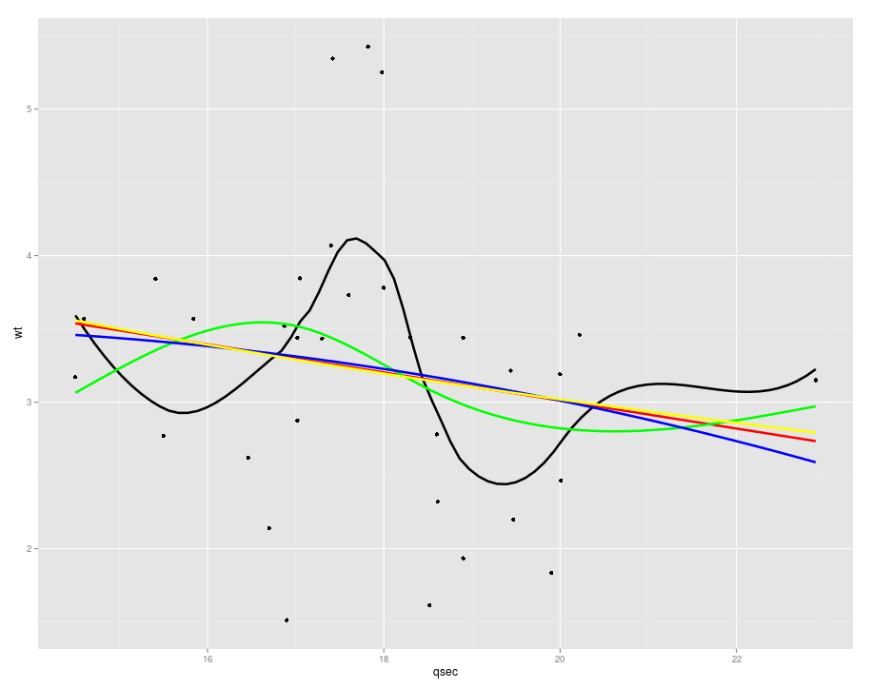
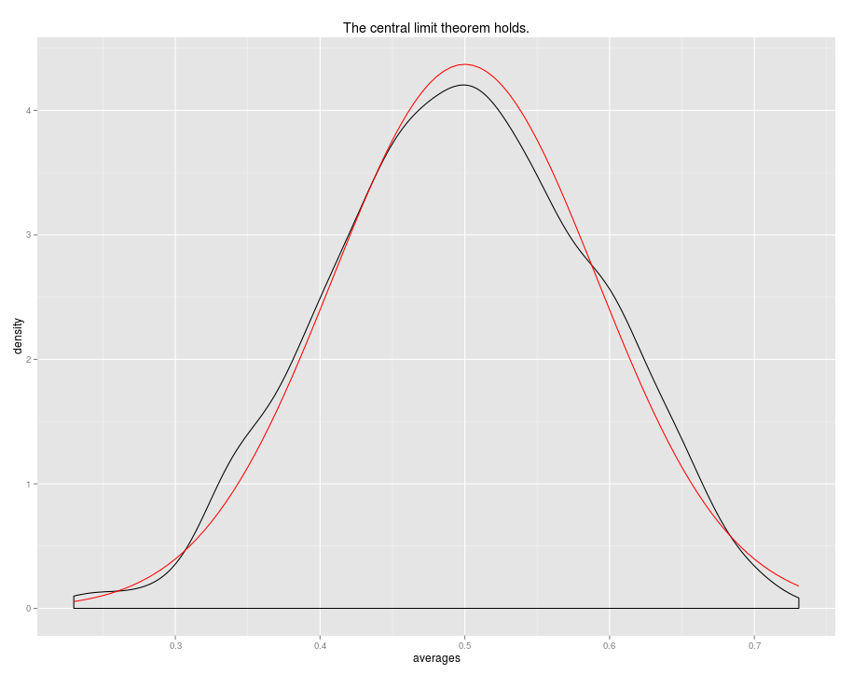
In this video we took a look at
how to use polynomials and splines to uncover trends when you don’t want to impose a particular model to the data.
how more complex models can be used using the parameter formula.
Next: user-defined functions

